Slide 1

Design of Computing Systems
Saptadeep Pal and Irina Alam
Slides partially adapted from:
Prof. Mani Srivastava, UCLA
Prof. Onur Multu, ETH Zurich

Slide 2
What are computers?
Computers are number crunching machines

Slide 3
Why do we need computers?
To Solve Problems
To Gain Insight
To Enable a Better Life and Future

Slide 4
How do computers solve problems?
Problem
Algorithm
Step by step procedure that is guaranteed to terminated
Each step is precisely stated
Can be carried out by a computer
Algorithm
Program/Language
System Software
SW/HW Interface
Micro-architecture
Logic Gates
Transistors
Electrons

Slide 5
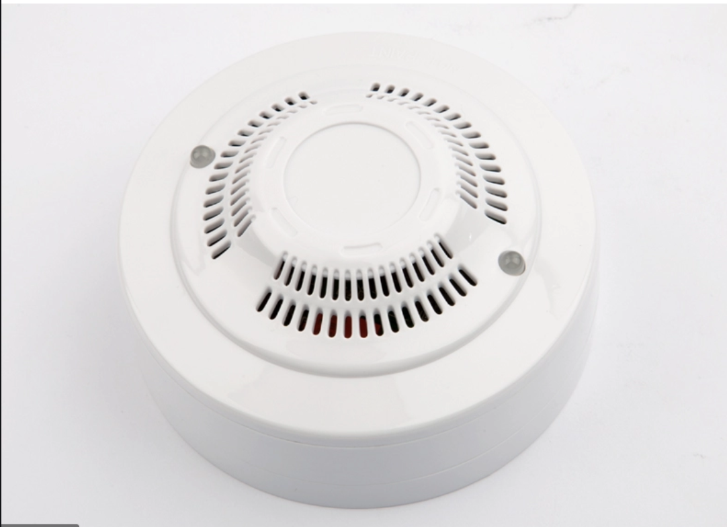
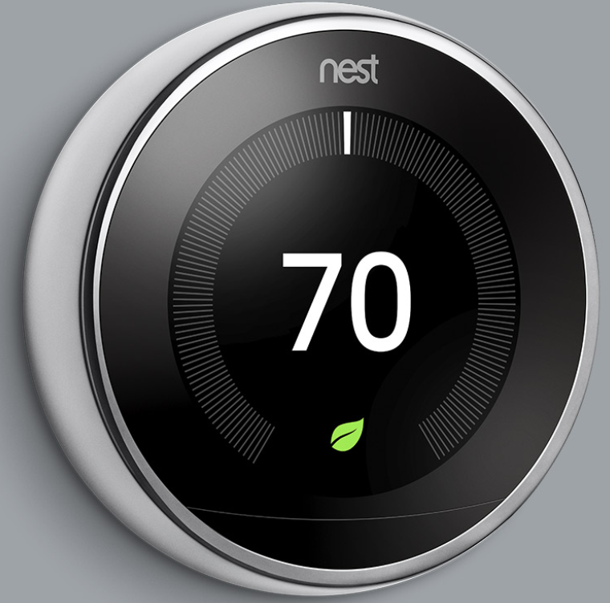
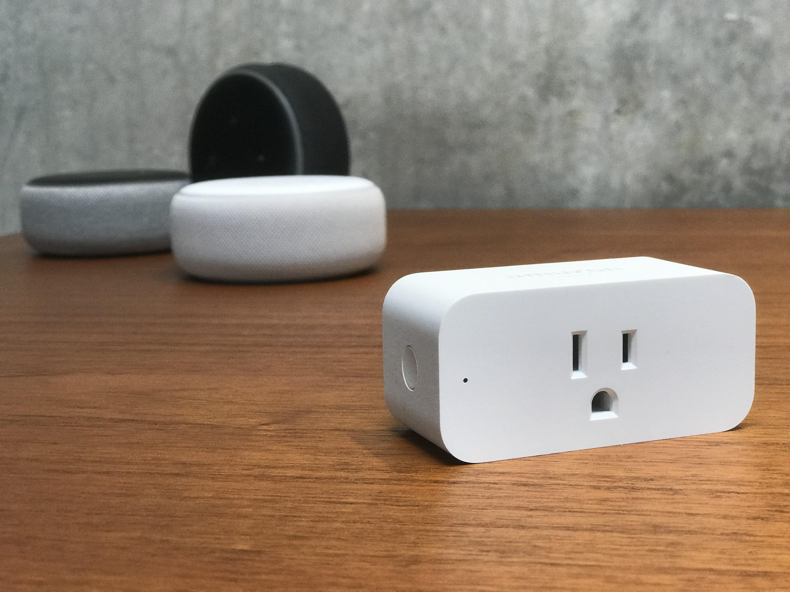
Computing systems around us (inside our homes)

Slide 6
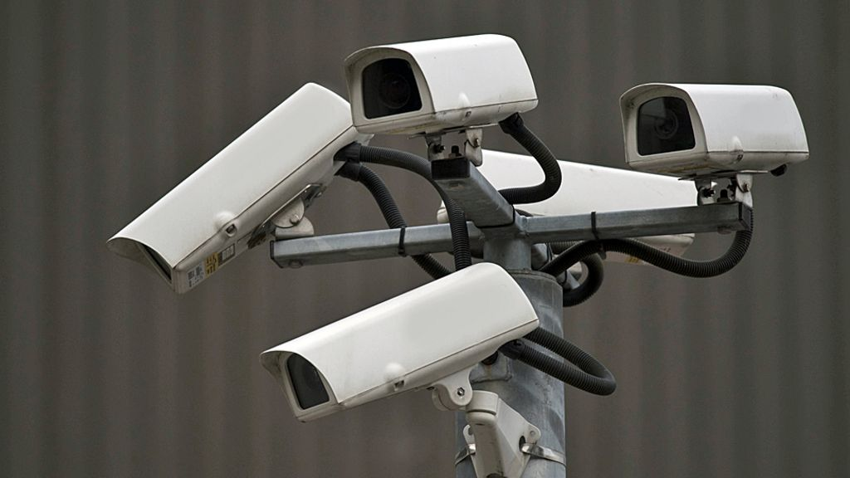
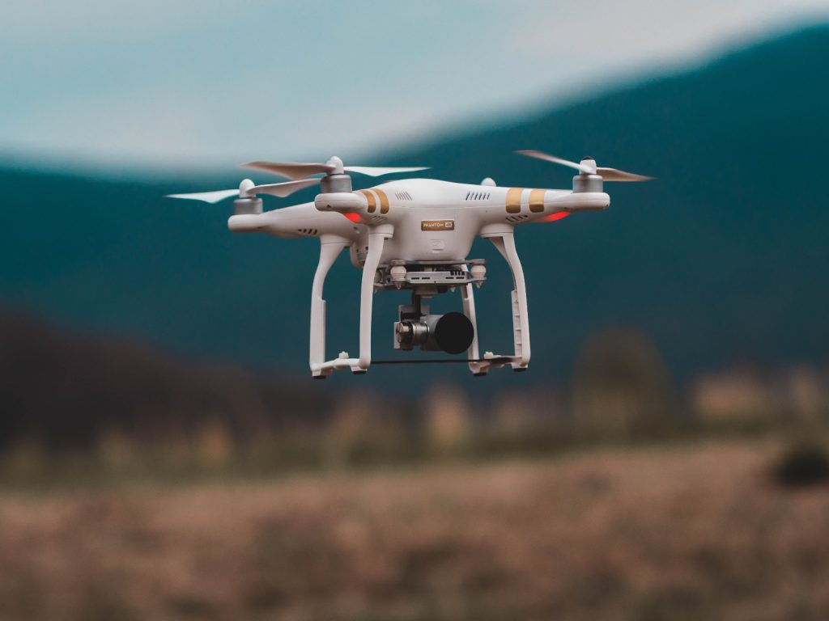
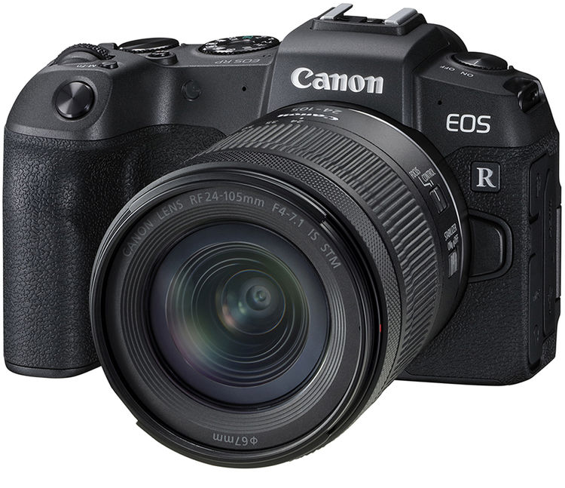
Cameras and drones

Slide 7
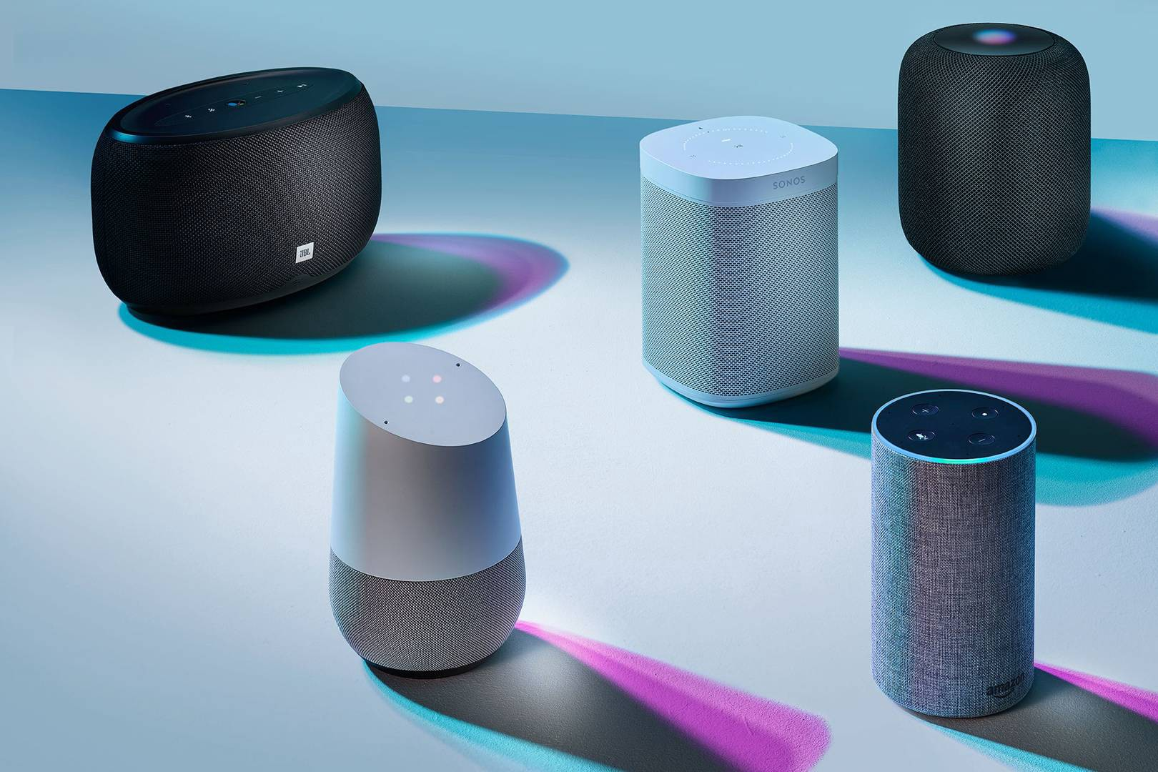
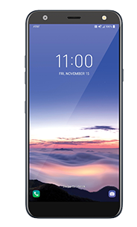
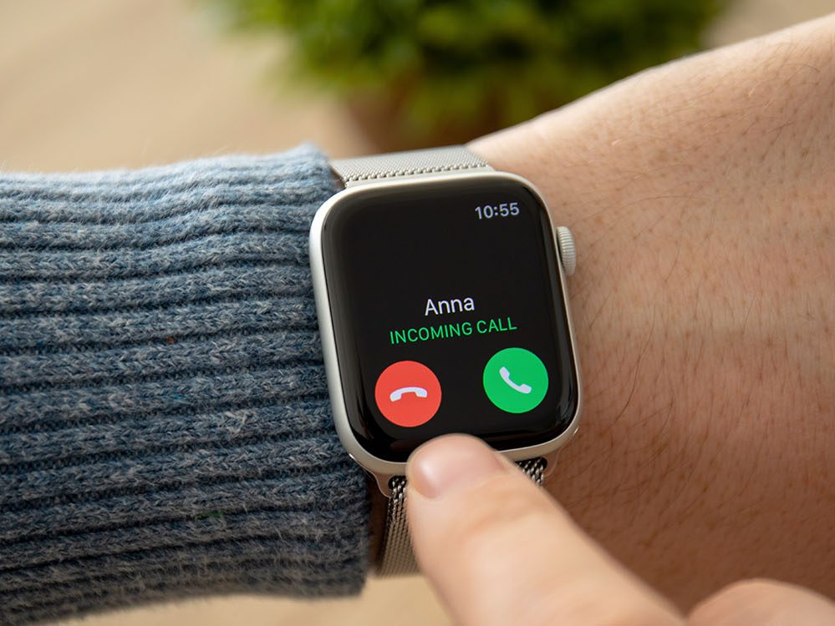
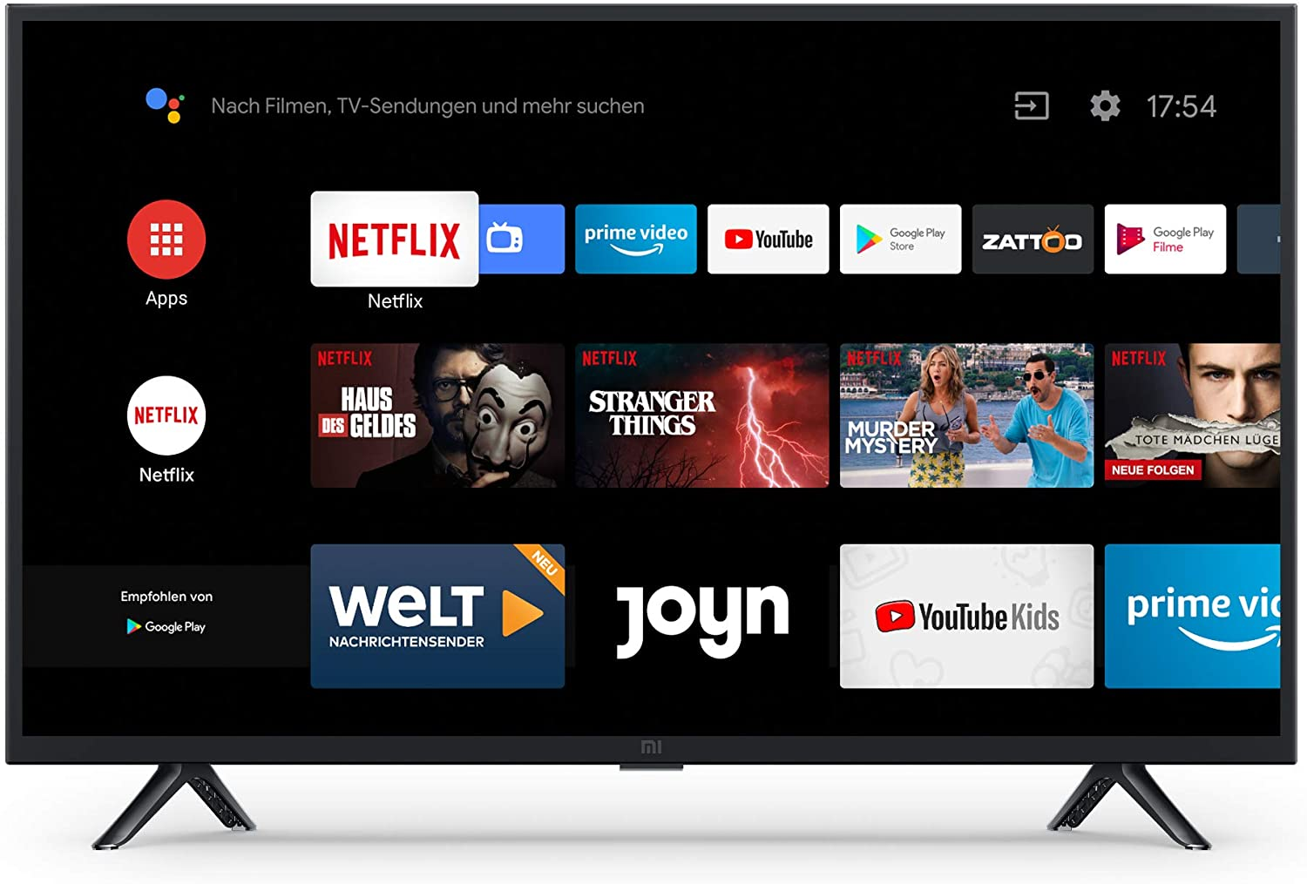
Computing systems around us

Slide 8
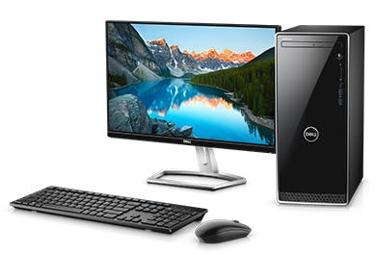
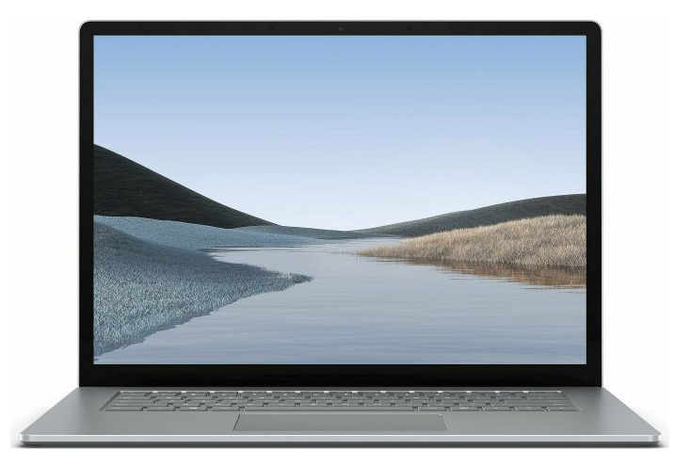
Personal computers

Slide 9
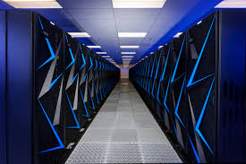
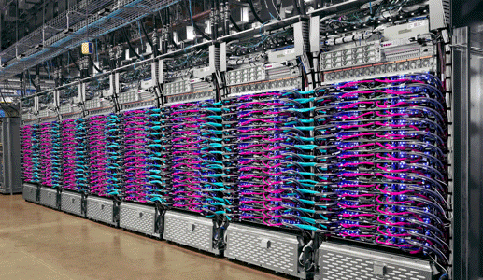
SUPERCOMPUTERS

Slide 10
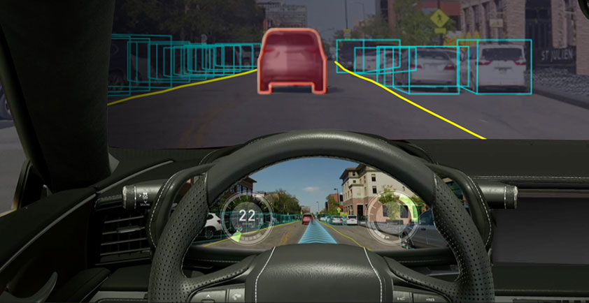
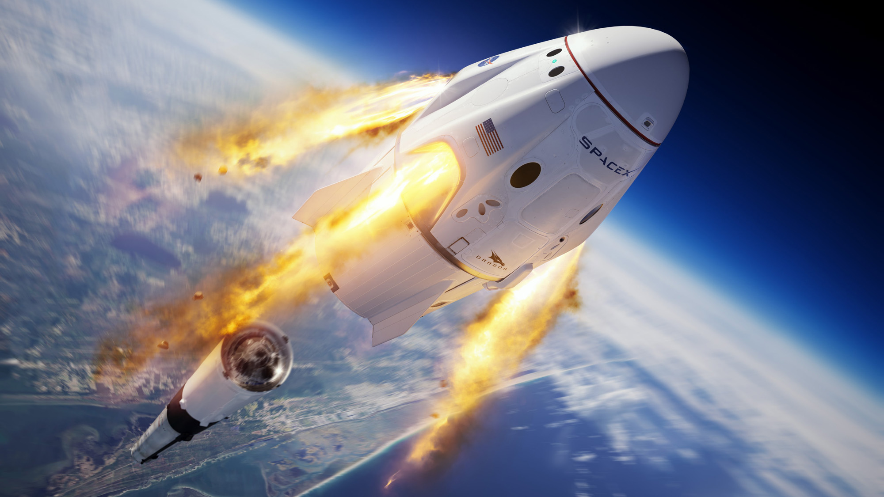
From cars to spaceships

Slide 11
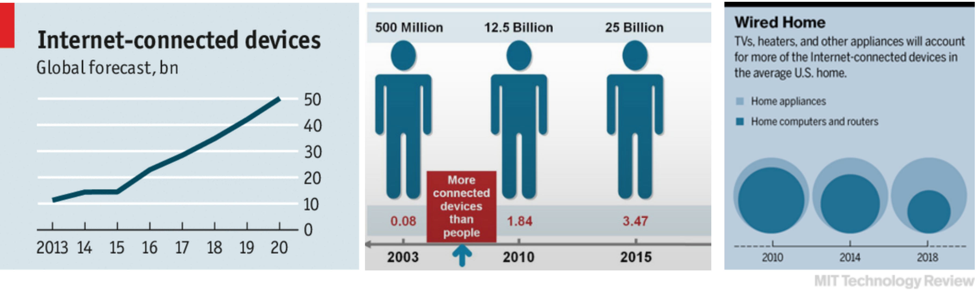
Embedded and connected everywhere
Everything has an Embedded Computer
The Internet is Everywhere
All Computers have a Network Interface

Slide 12
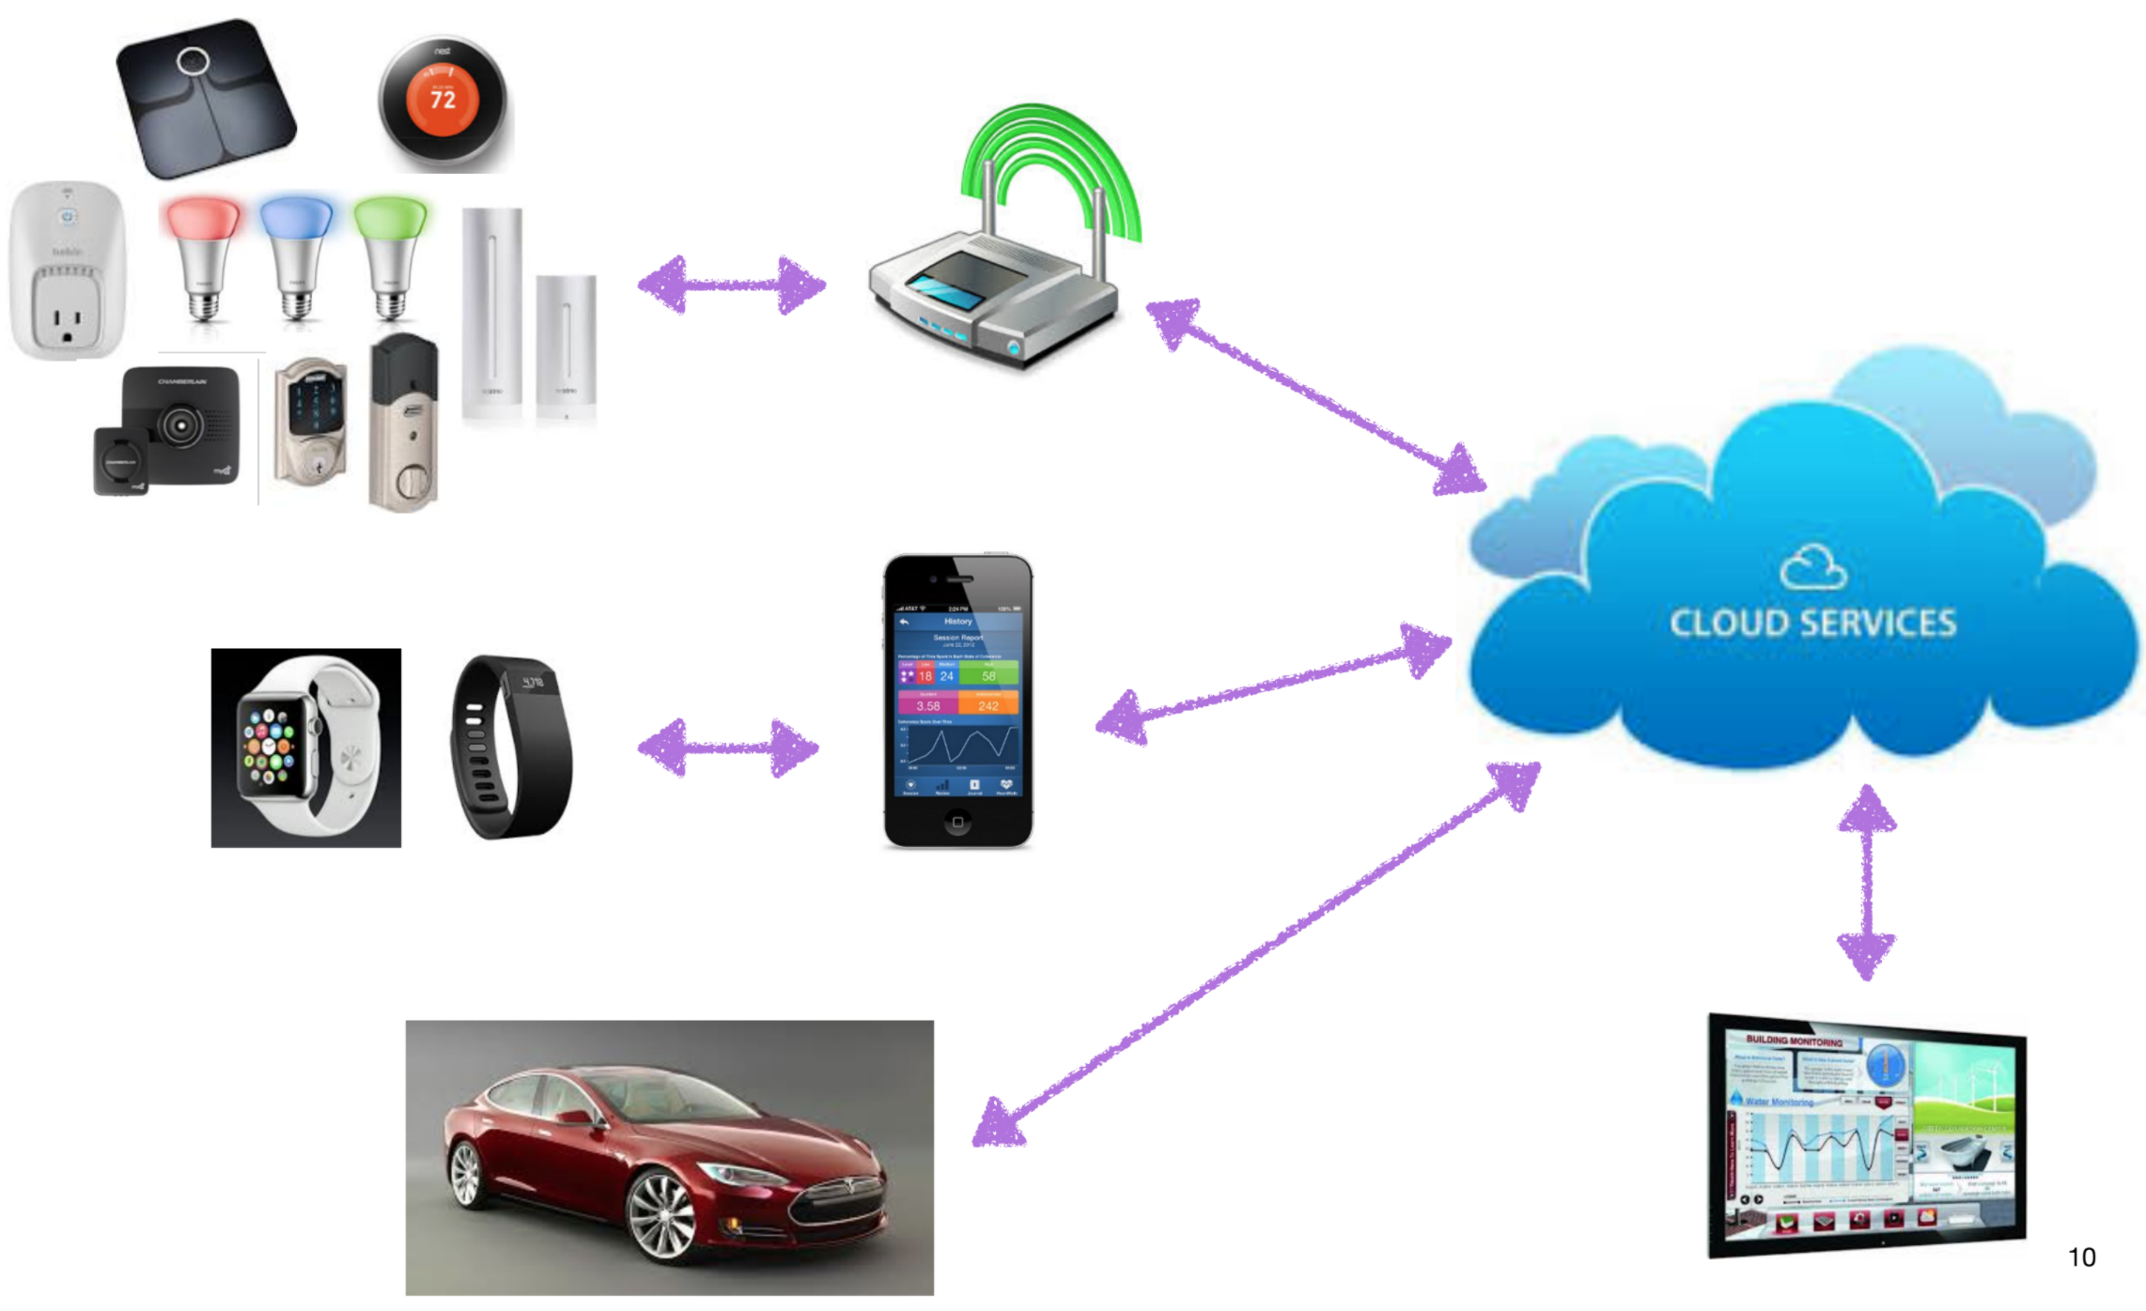
A connected world

Slide 13
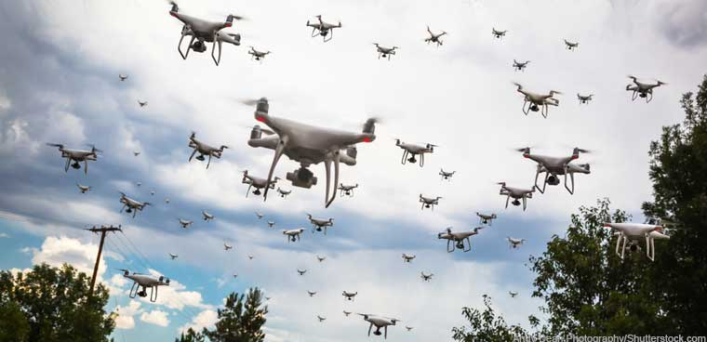
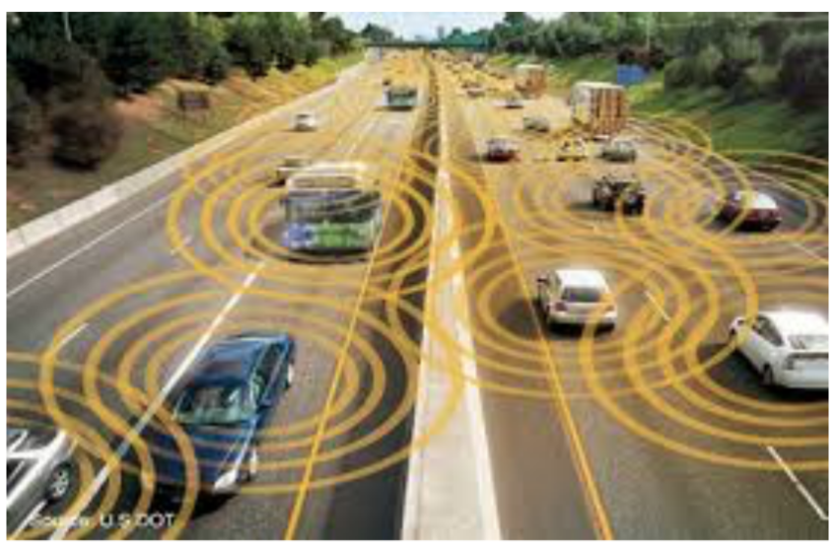
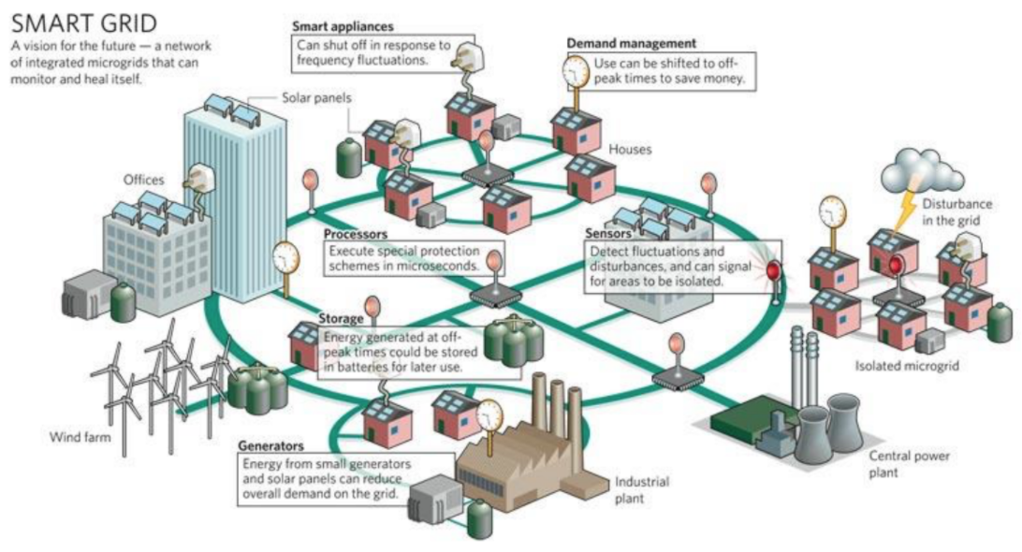

the connected world

Slide 14
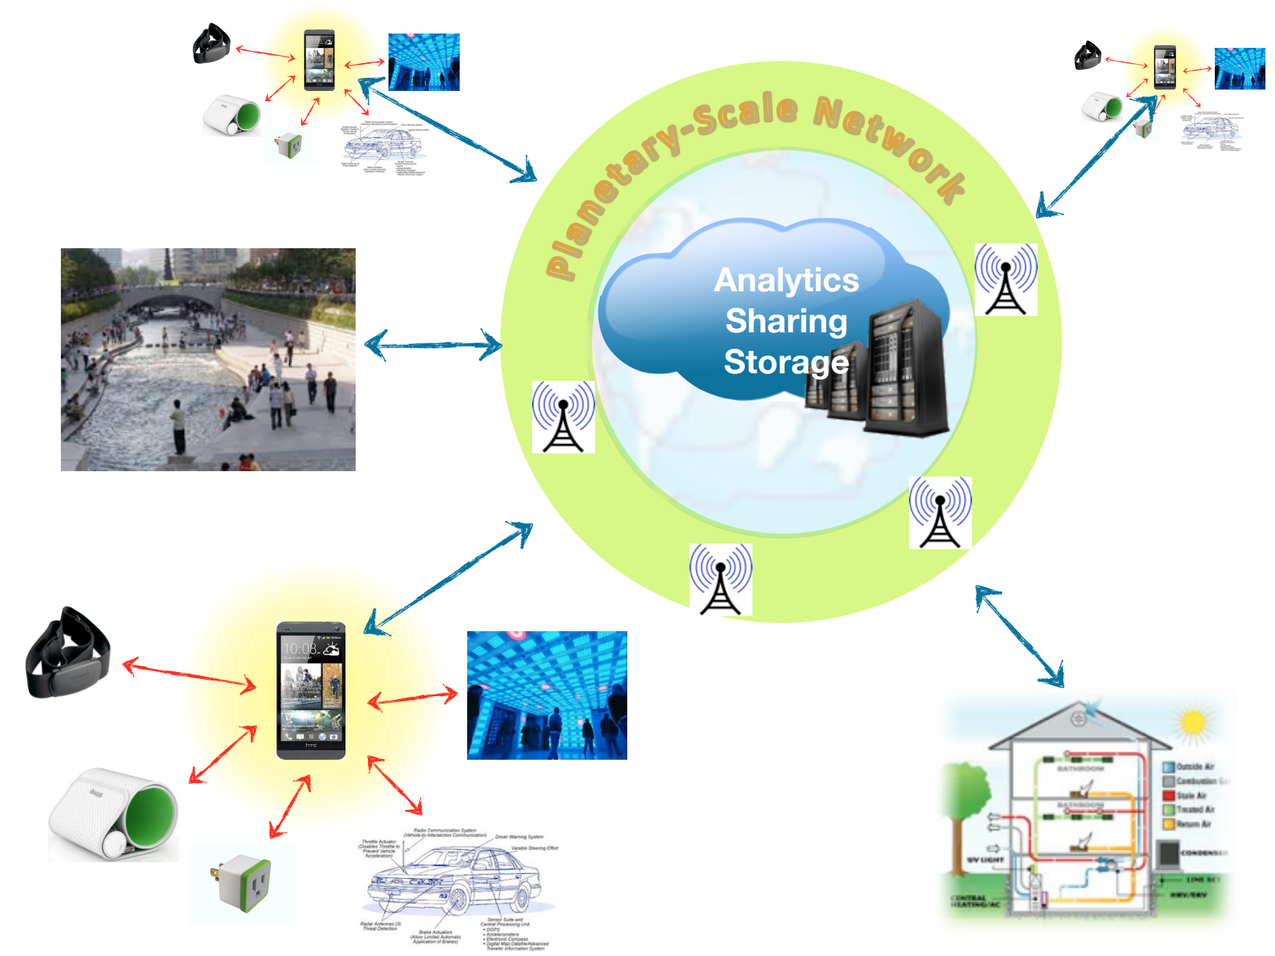
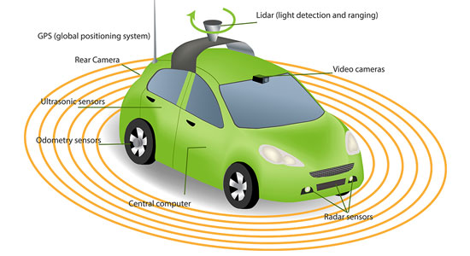

A rich ecosystem of interlinked technologies

Slide 15
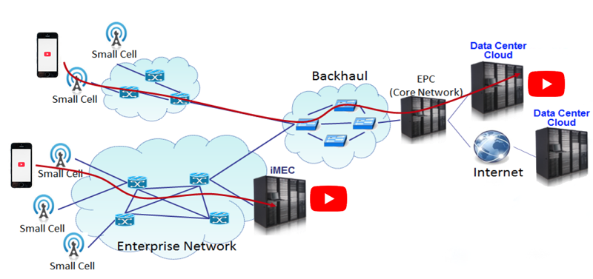
Networked systems
Each system in this ecosystem has different goals and constraints

Slide 16
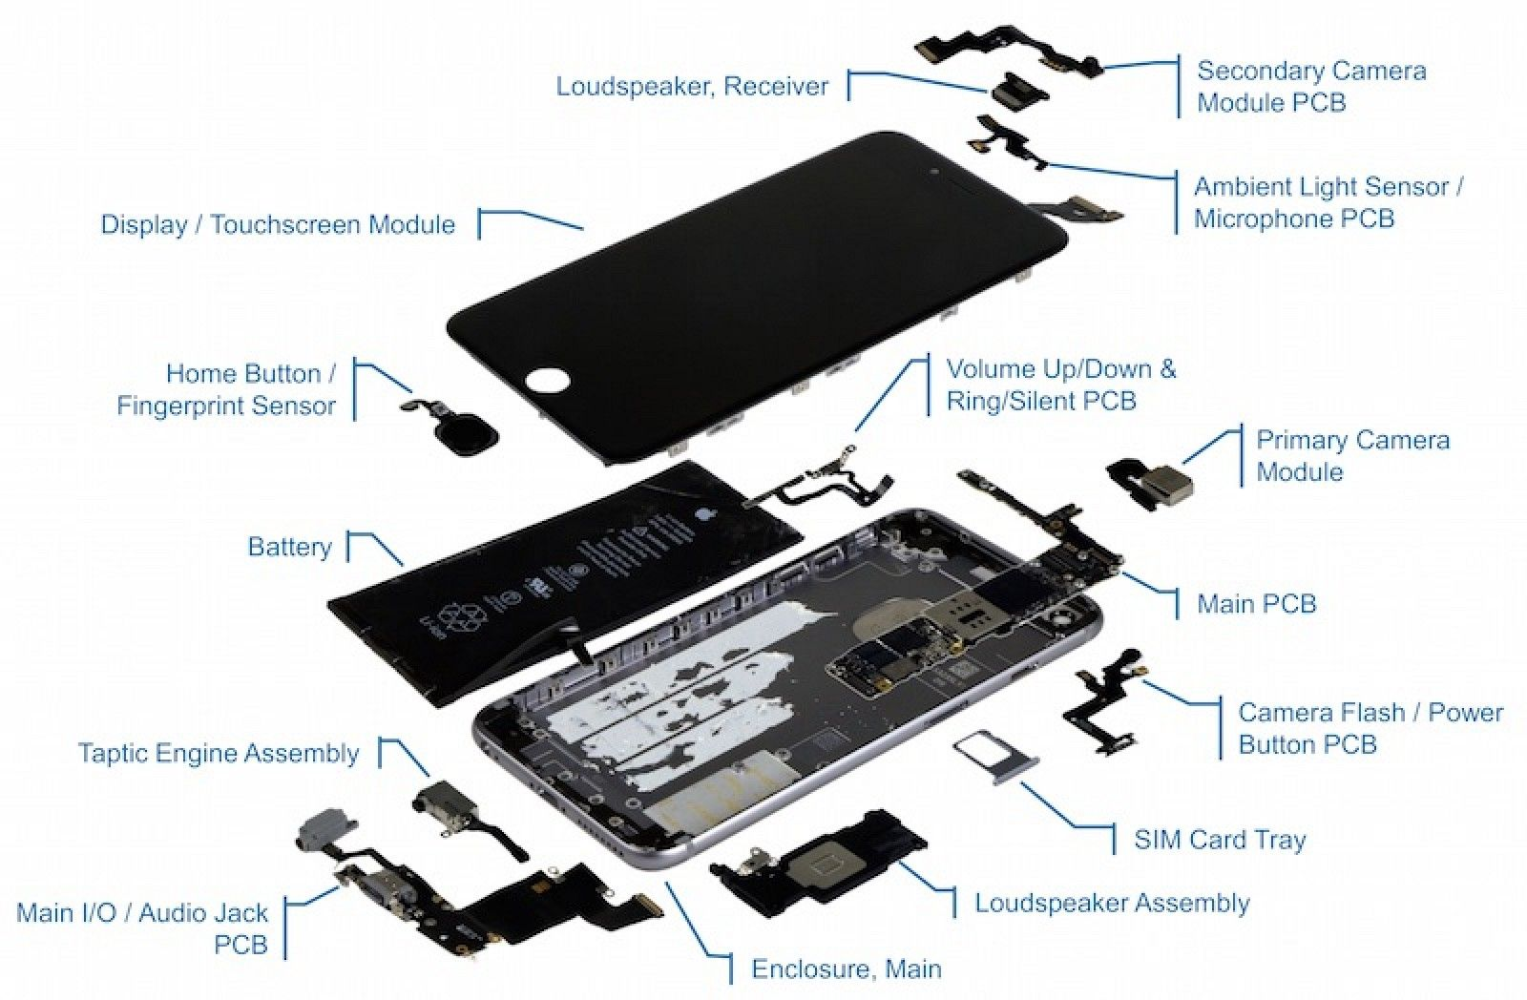
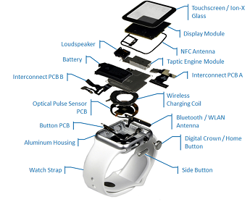
Let’s look at an overall system (gadgets)

Slide 17
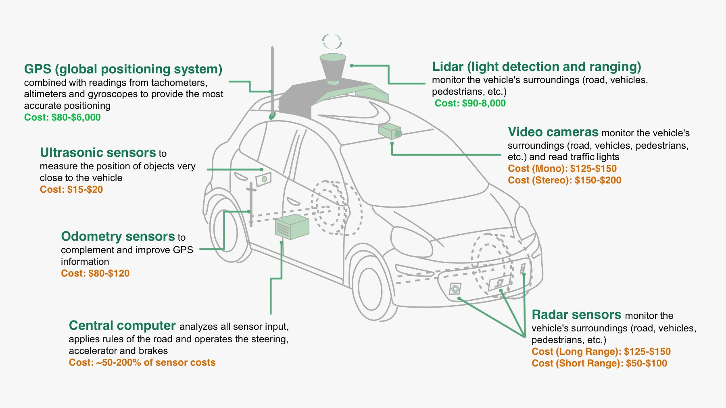
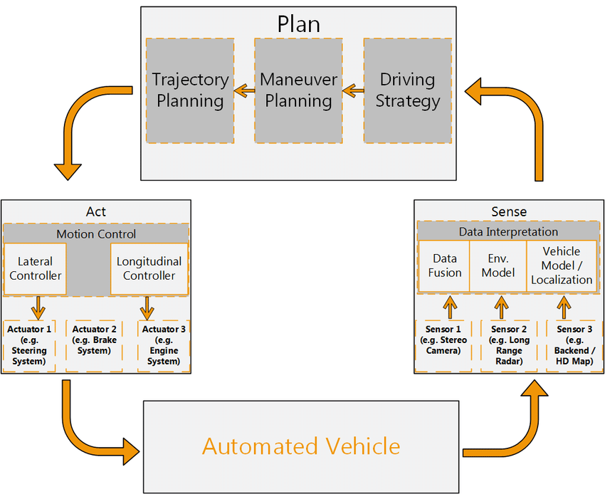
Let’s look at an overall system (autonomous cars)

Slide 18
Every computing system is trying to solve problem(s)
Problem
Algorithm
Different systems, different problems to solve
Different systems, different goals to achieve
Program/Language
System Software
SW/HW Interface
Micro-architecture
Logic Gates
Transistors
Electrons

Slide 19
Architecting computing systems
Science and Art of designing computing platforms (hardware, interface, system software and programming model)
Achieve a set of design goals
Best possible performance (supercomputers)
Longest battery life/ less power consumption (sensors, wearables)
Small form factor and light weight (Phones, watches, drones)
Good average performance at affordable cost (Laptops, desktops)
Highly reliable systems (autonomous vehicles, medical robots, spaceships)
…….

Slide 20
Components of a computing system - electrons
Electronics is driven by laws of physics
Computing systems orchestrate electrons to do tasks
Problem
Algorithm
Program/Language
System Software
SW/HW Interface
Micro-architecture
Logic Gates
Transistors
Electrons

Slide 21
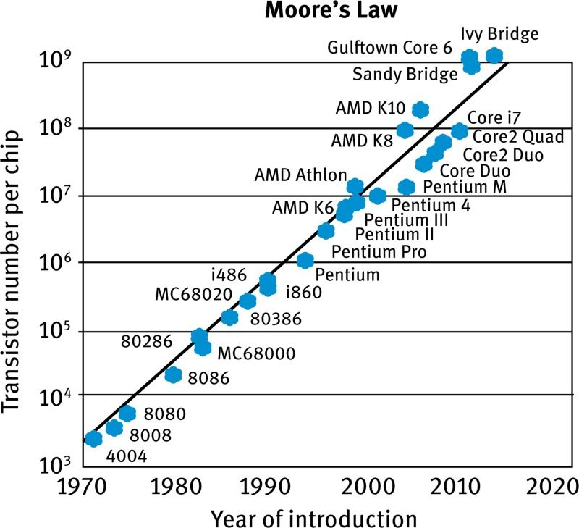
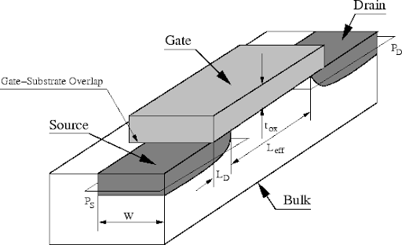
Components of a computing system - transistors
Transistors control flow of electrons
Transistors act as switches in digital systems – 1/0
Semiconductor physics deals with design of transistors
More the number of transistors, more powerful is the computing system
Also, more area and power
Over years, transistors have become smaller
Same area – more transistors
Reduced power
Problem
Algorithm
Program/Language
System Software
SW/HW Interface
Micro-architecture
Logic Gates
Transistors
Electrons

Slide 22
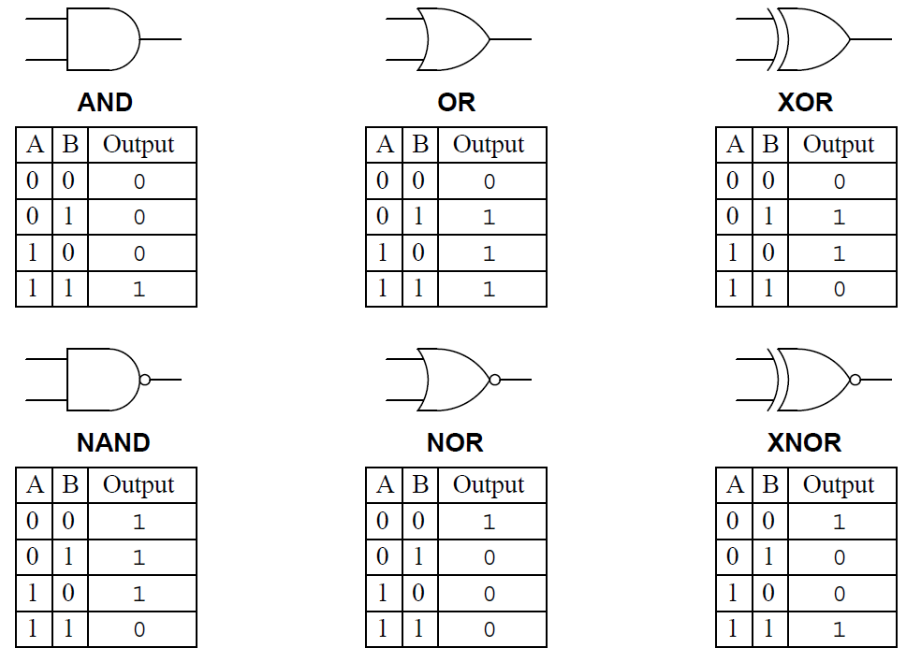
Components of a computing system – Logic gates
Logic gates are the building blocks of digital systems
Multiple transistors are combined to build logic gates
Examples: AND, OR, NOT, XOR
Problem
Algorithm
Program/Language
System Software
SW/HW Interface
Micro-architecture
Logic Gates
Transistors
Electrons

Slide 23
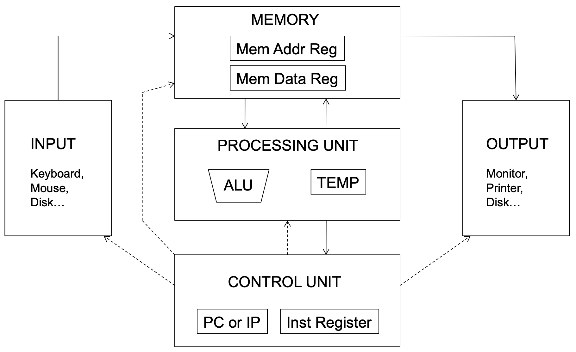
Components of a Computing system – micro-architecture
The Von Neumann Model
Problem
Algorithm
Program/Language
System Software
SW/HW Interface
Micro-architecture
Logic Gates
Transistors
Electrons

Slide 24
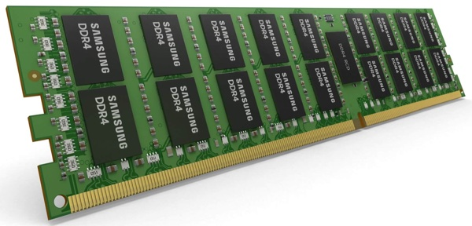
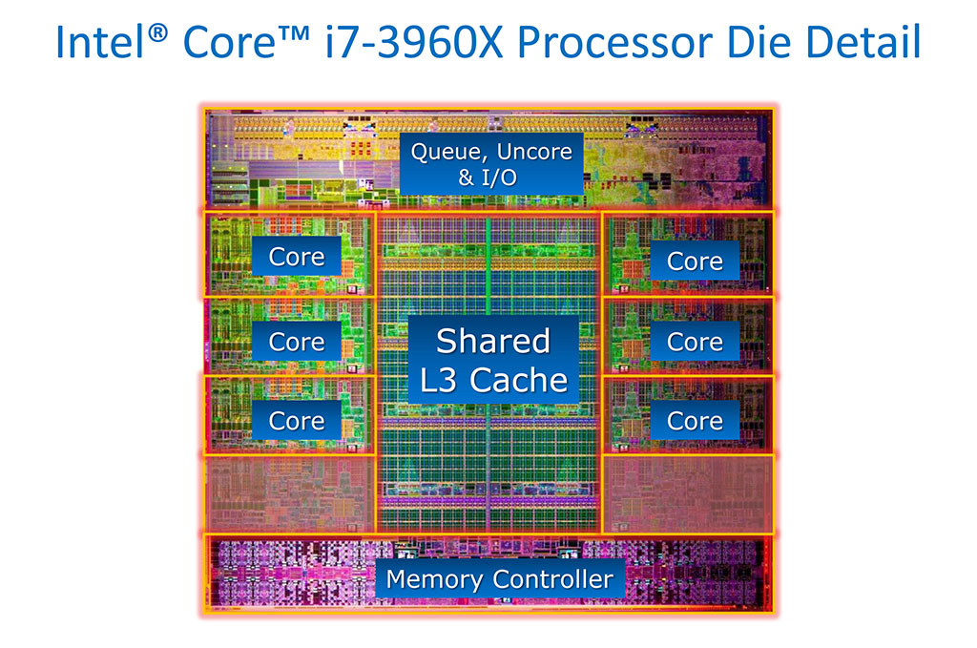
Components of a computing system – micro-architecture
The Von Neumann Model

Slide 25
Different flavors of processing unit
Arithmatic and Logic Unit + Registers
Single or multiple cores in a system
Each core – several processing elements
Different types of cores –
Fast, High energy consumption
Slow, energy efficient

Slide 26
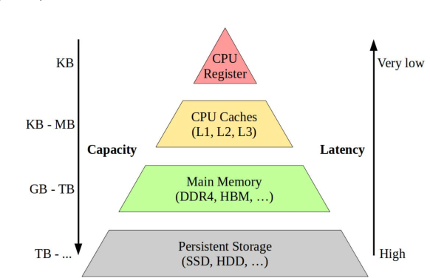
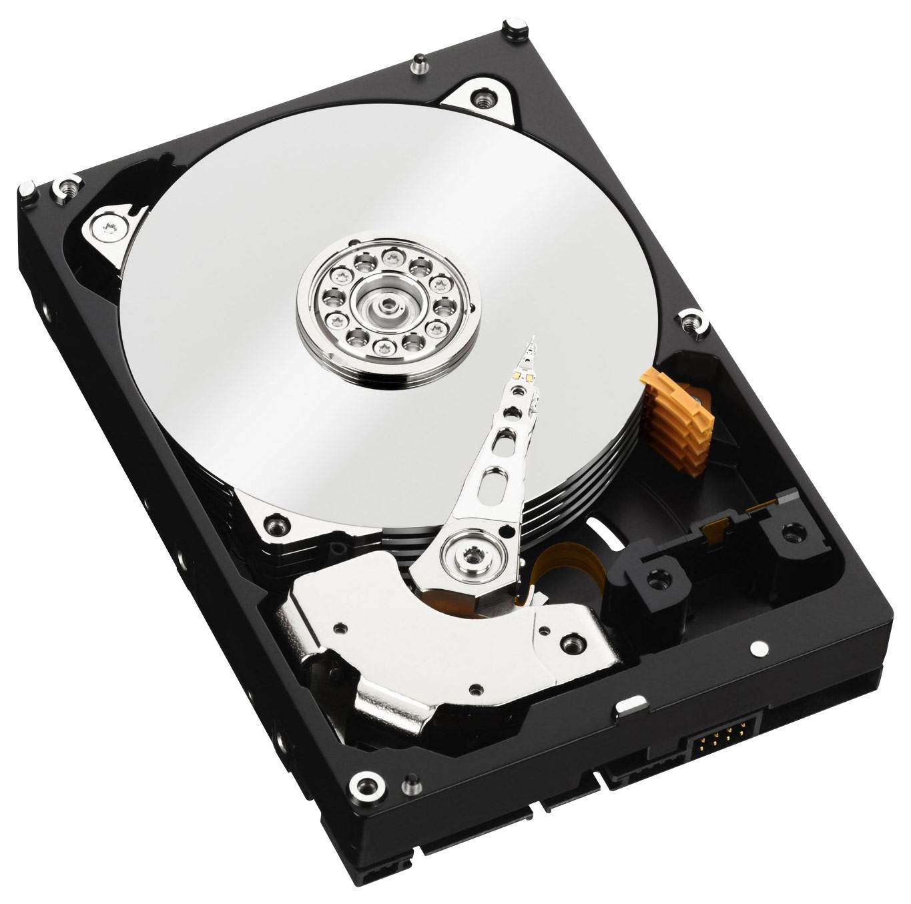
Different flavors of memory
Caches + Main Memory + Storage
Caches – Smaller, faster on-chip memory, temporary
Main Memory – Bigger, moderately fast, off-chip, temporary/persistent
Storage – Biggest, slowest, off-chip, persistent

Slide 27
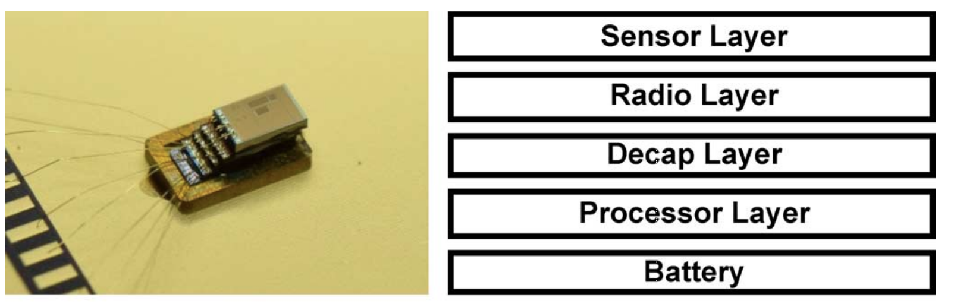
Different platforms, different goals
Temperatur Sensor
Very Lightweight processor
Few thousand transistors
Area – 0.09mm² (180nm technology)
Power – 71nW
Memory – Few 10s of kilobytes (KBs)

Slide 28
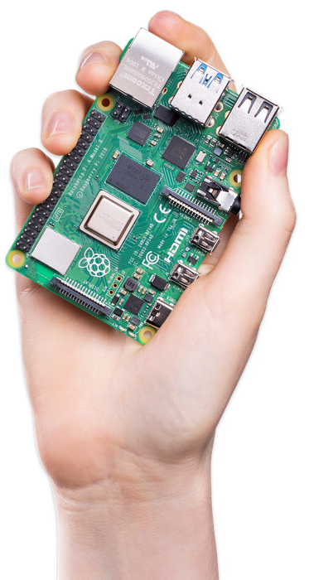
Different platforms, different goals
Raspberry Pi
Lightweight processor
~250 million transistors
Area – ~50mm² (40nm technology)
Power – 1-2W
Memory – Few gigabytes (GBs) of memory

Slide 29
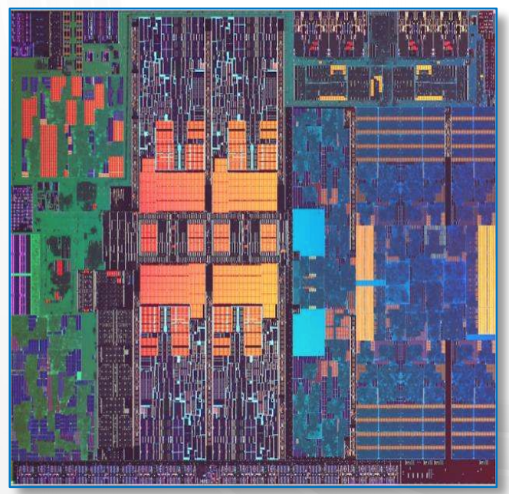
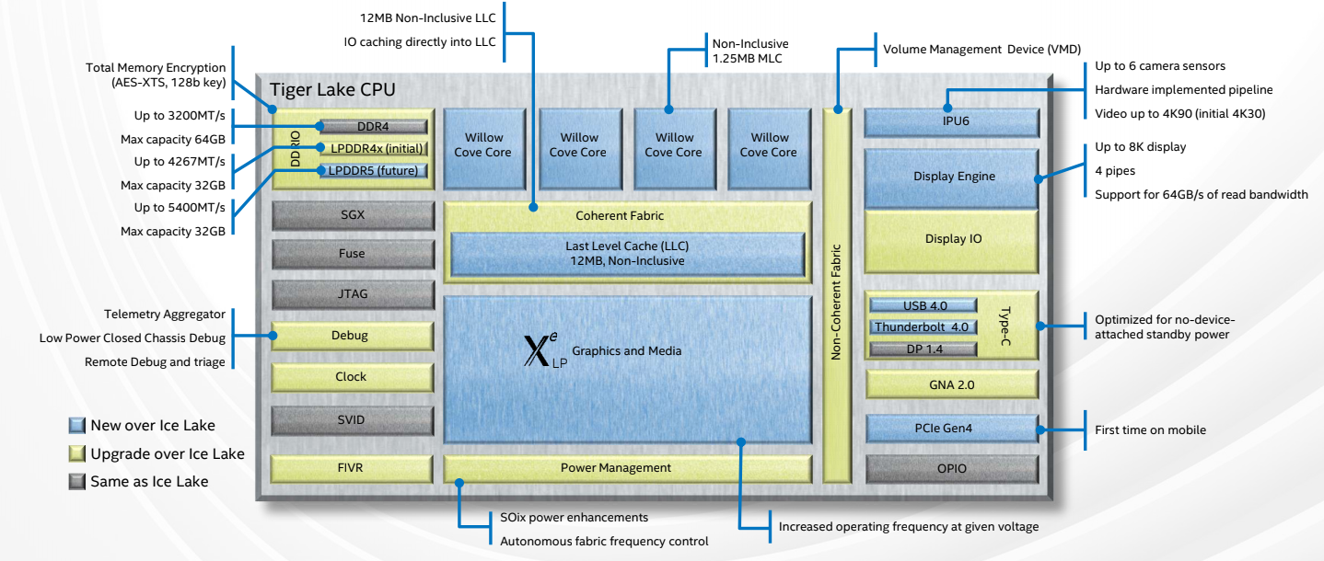
Different platforms, different goals
Intel Tiger Lake
Mobile processor
>10 billion transistors
Area – ~150mm² (10nm technology)
Power – 15W
Memory – 10s of MBs of ultra-fast memory 10s of GBs of slower memory

Slide 30
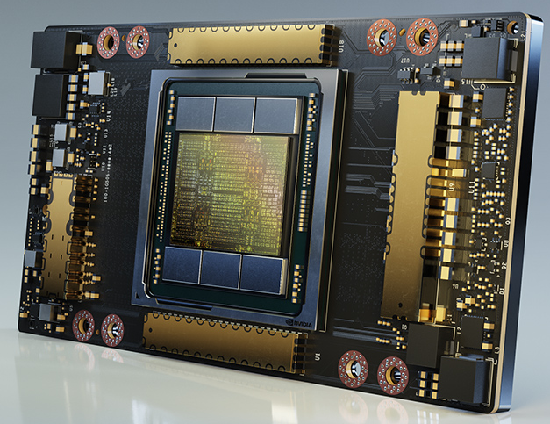

Different platforms, different goals
NVIDIA A100 GPU
Used for graphics and AI training
>54 billion transistors
Area – ~800mm² (7nm technology)
Power – 400W
Memory – 100s of MBs of ultra-fast memory 100s of GBs of fast memory TBs of slower memory

Slide 31
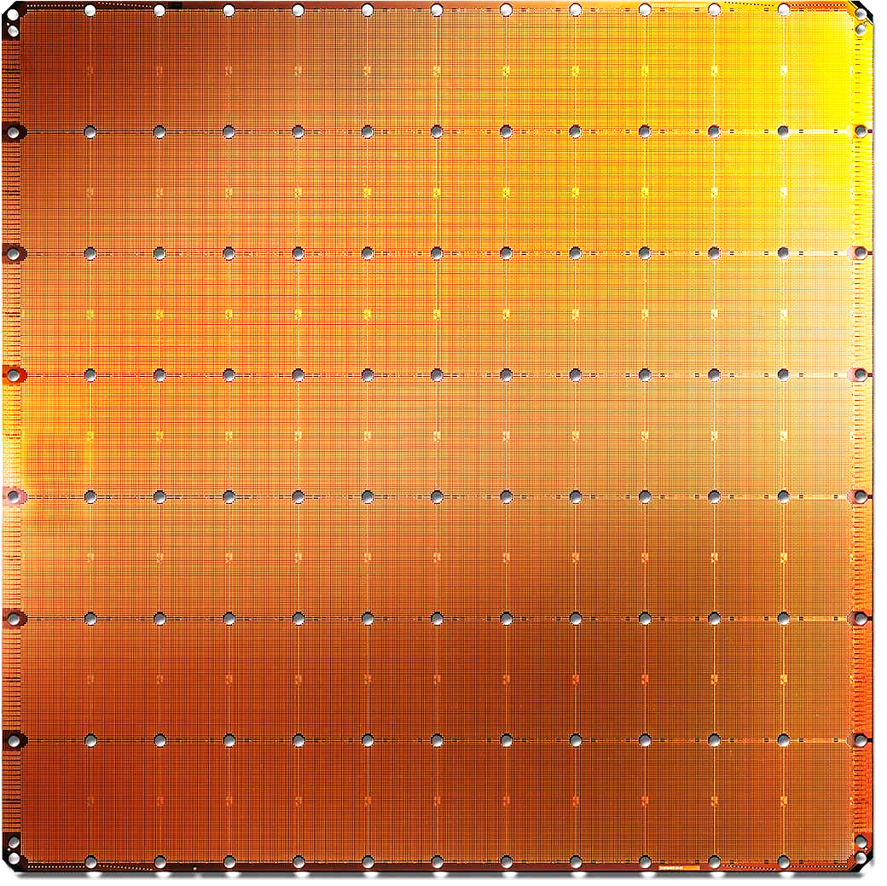
Different platforms, different goals
Cerebras Waferscale System
Used for AI training and inference
>2 trillion transistors
Area – ~46000mm² (7nm technology)
Power – 20KW
Memory – 10s of GBs of ultra-fast memory

Slide 32
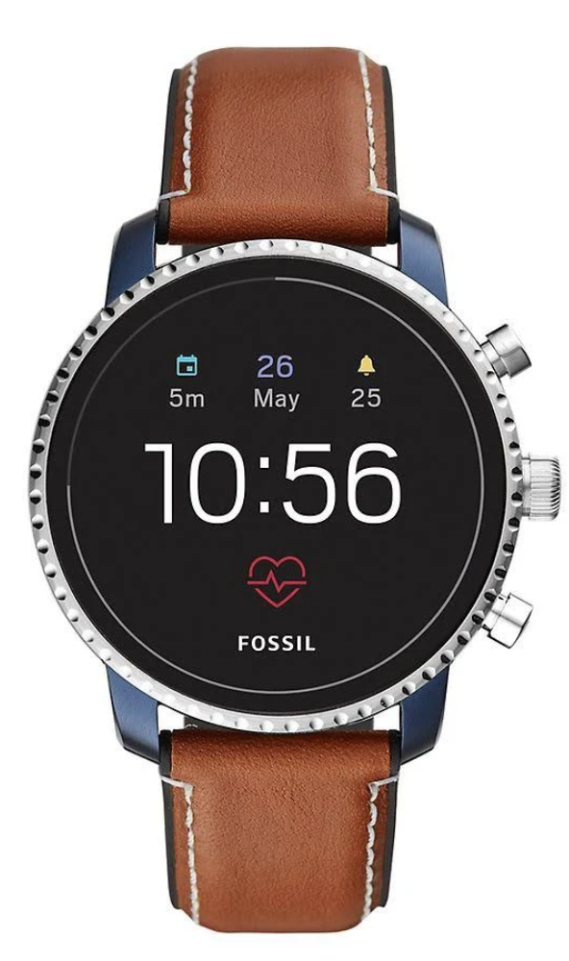
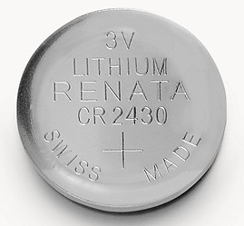
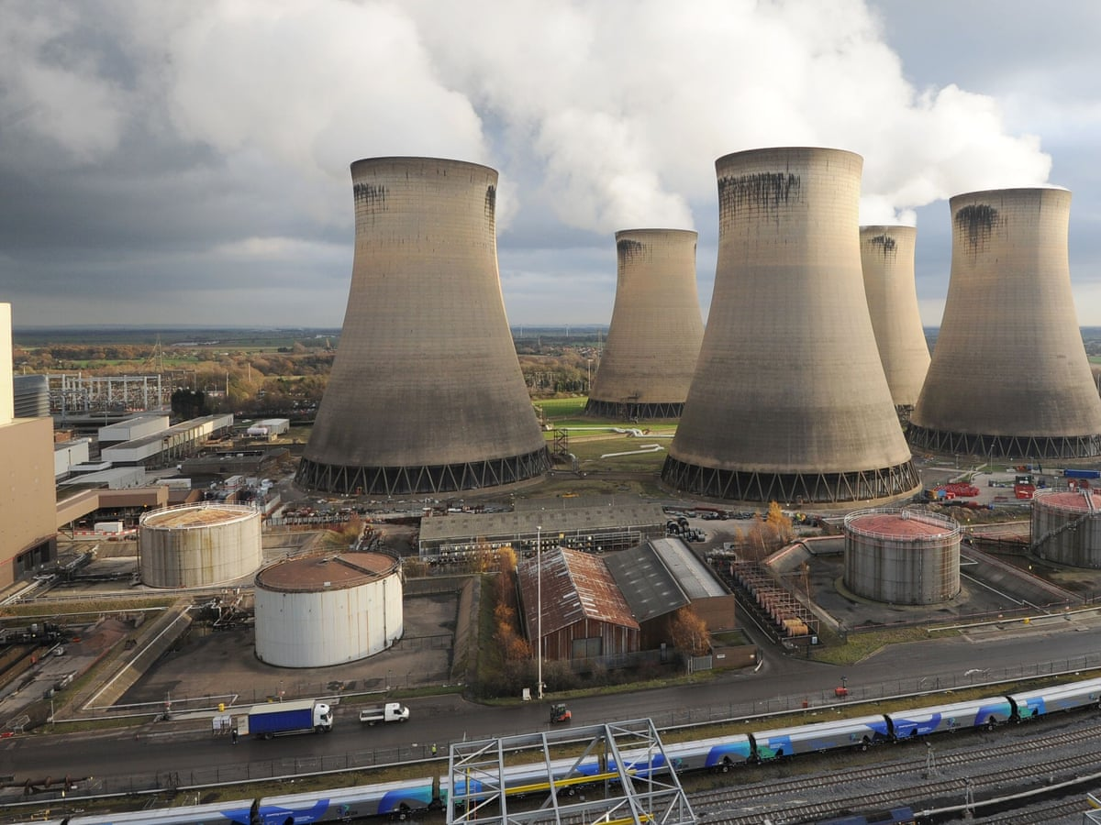
Different platforms, different constraints (Power)
What is the difference between the design goals of these two systems?

Slide 33
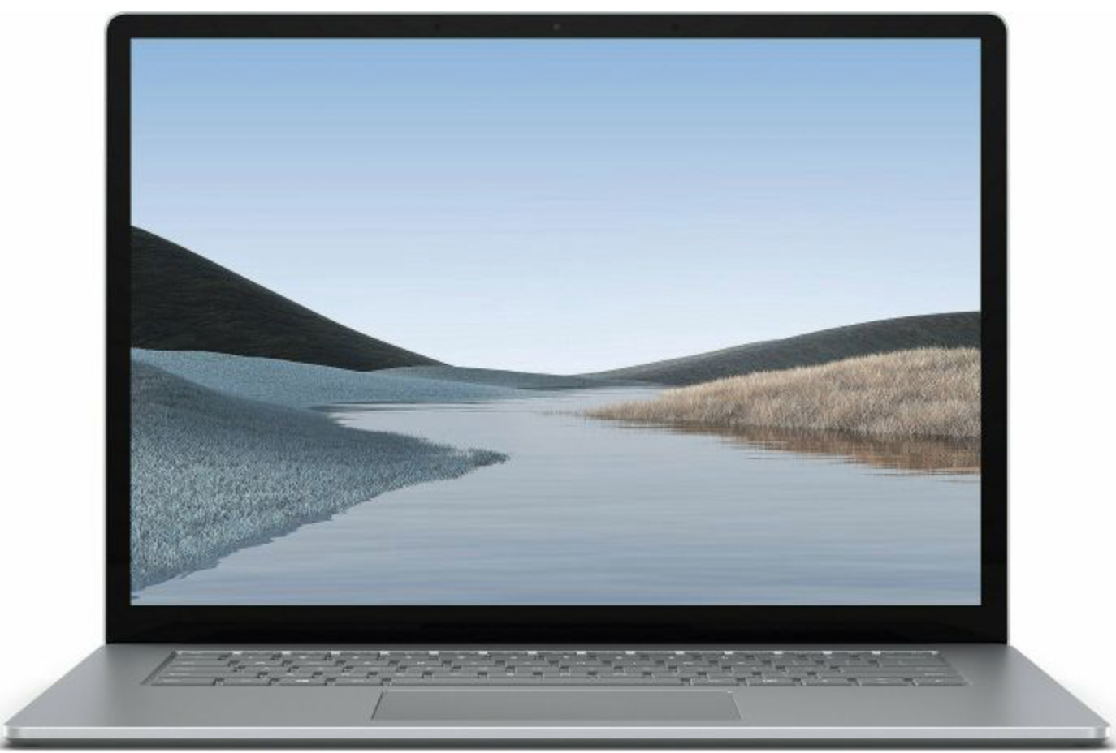
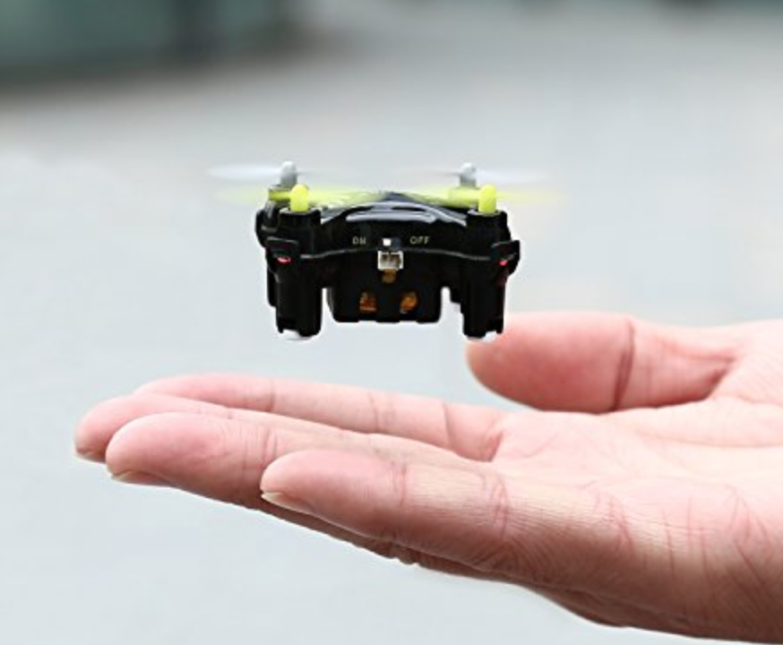
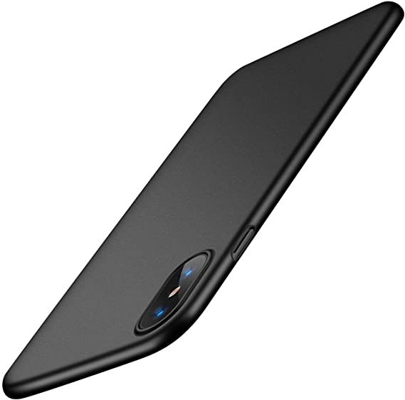
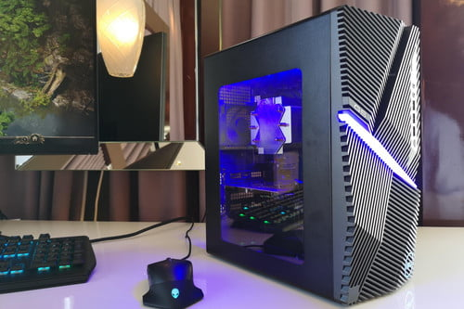
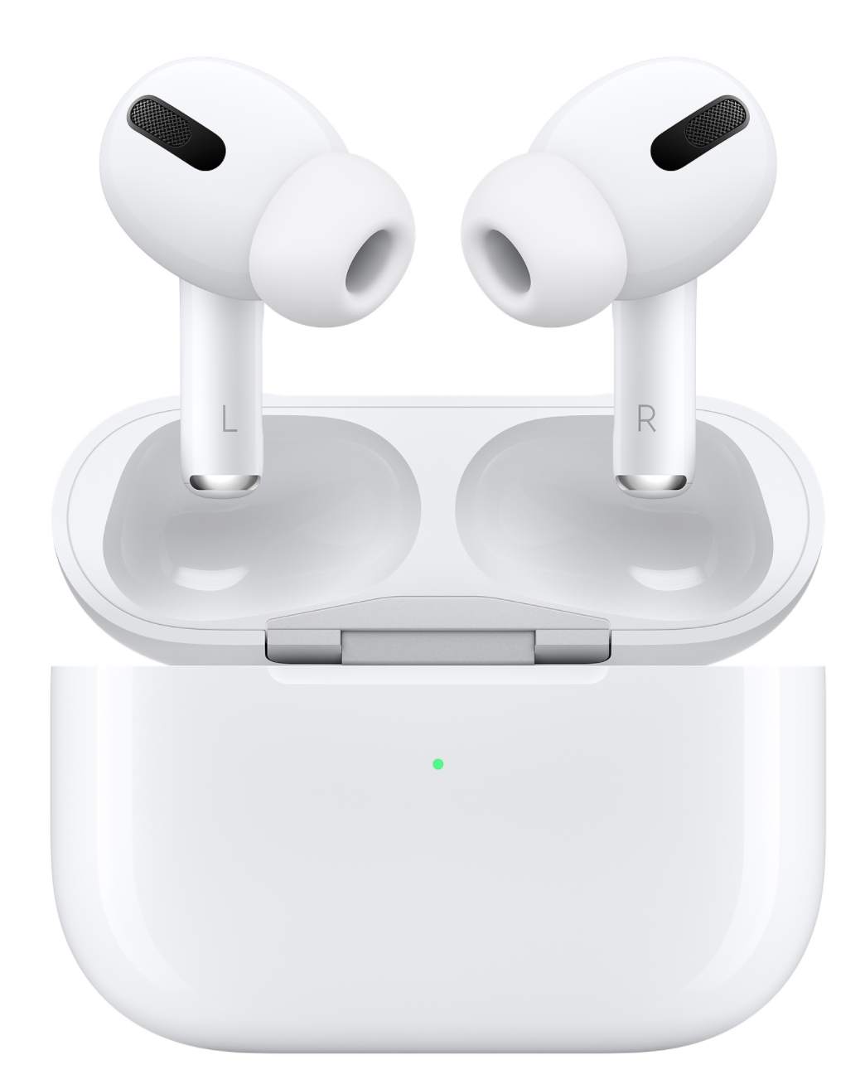
Different platforms, different constraints (Form Factor and WEIGHT)

Slide 34


Different platforms, different constraints (thermal)

Slide 35




Different platforms, different constraints (Resiliency)
What is the difference between the design goals of these systems?

Slide 36




General purpose vs. Application specific

Slide 37
Computing Systems run software
Wide choice of software abstractions exist
General purpose languages like Python/C++ etc. are easy to learn
Not all systems can be programmed using these languages
Domain specific hardware often performs efficiently when programmed using not commonly used languages
Providing nice software interface to programmers is important
Designing software stack - important part of designing hardware systems
Hot and active field in Computer Engineering
Problem
Algorithm
Program/Language
System Software
SW/HW Interface
Micro-architecture
Logic Gates
Transistors
Electrons

Slide 38
Crux of designing computing systems
Different systems, different problems to solve
Different systems, different goals to achieve
Different systems, different constraints to obey
Multiple choices available to achieve same goal
Computing system design is the art and science of choosing the optimal set
Designing computing systems – interdisciplinary task
From controlling electrons efficiently to writing optimized programs
Holistic across-the-stack thinking is required

Slide 39





SECURITY – another important aspect of system design

Slide 40
Thank you!
Exciting exercises to follow next

